Slide 1

Kisaan Saathi AI: Empowering Indian Farmers
A mobile-first solution delivering timely, localized agricultural advice to smallholder farmers in India — in English, Hindi, and Marathi. Combines human-centered UX with AI-driven agronomy to increase yield, reduce input cost, and improve livelihoods.

Slide 2

Methodology :-
Built a cross-platform Expo React Native app for mobile device user interface (UI).
Backend connects to MySQL database and integrates Google Gemini AI.
Users interact in English, Hindi or Marathi.
Technologies Used :-
React Native & Expo for frontend.
Python flask for backend.
MySQL for database .

Slide 3


Languages Used :-
Java Script (JS).
Python.
MySQL.
Problem Statement :-
.
Many farmers lack access to expert agronomic
support.
They face crop issues, pests and fertilizer decisions
with limited information.
This leads to reduced yields and increased costs.

Slide 4
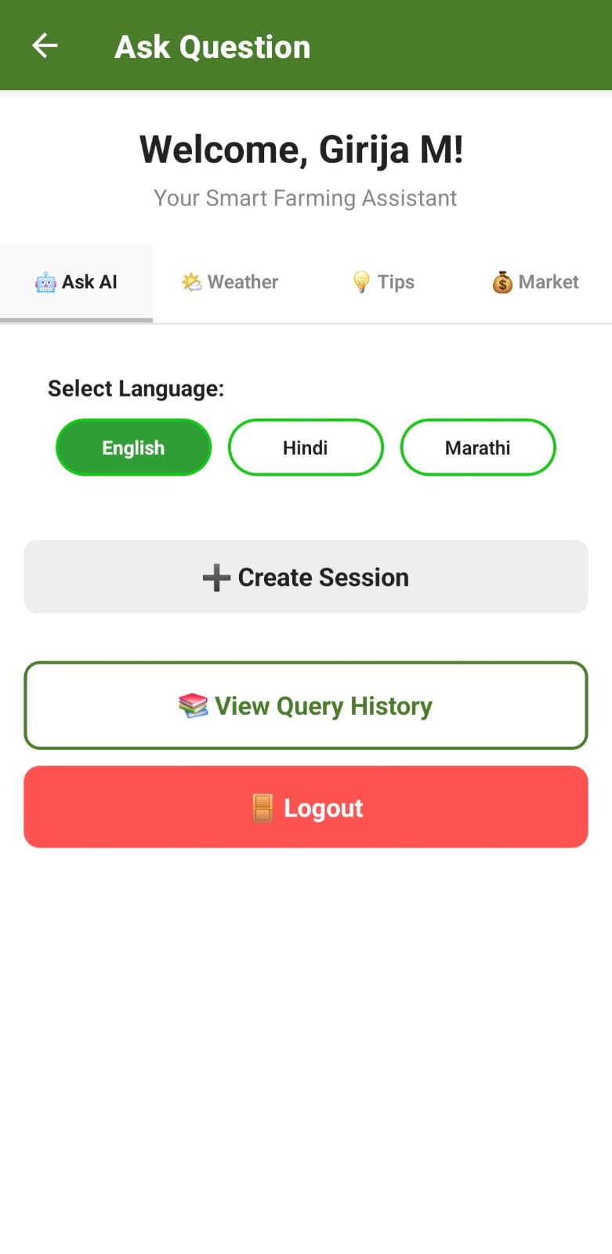

Problem Solution :-

Slide 5
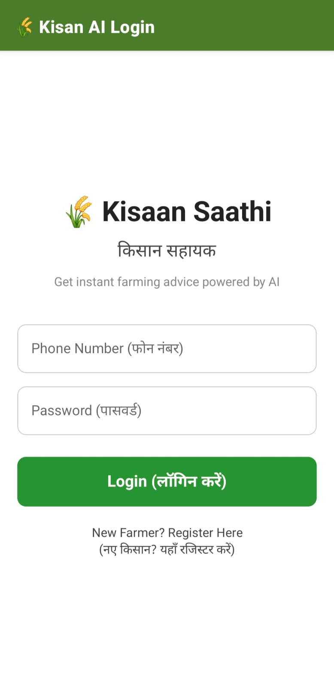
How it Works — User Experience
Signup / Login with phone number — secure, simple authentication.
Choose language (English, Hindi, Marathi) and set farm profile (location, crops, area).
Ask AI: type questions about pests, fertilizer, or crop care.
Create a Farm Session for targeted fertilizer plans and follow-up.
View history, tips, weather updates, and market price pointers.

Slide 6
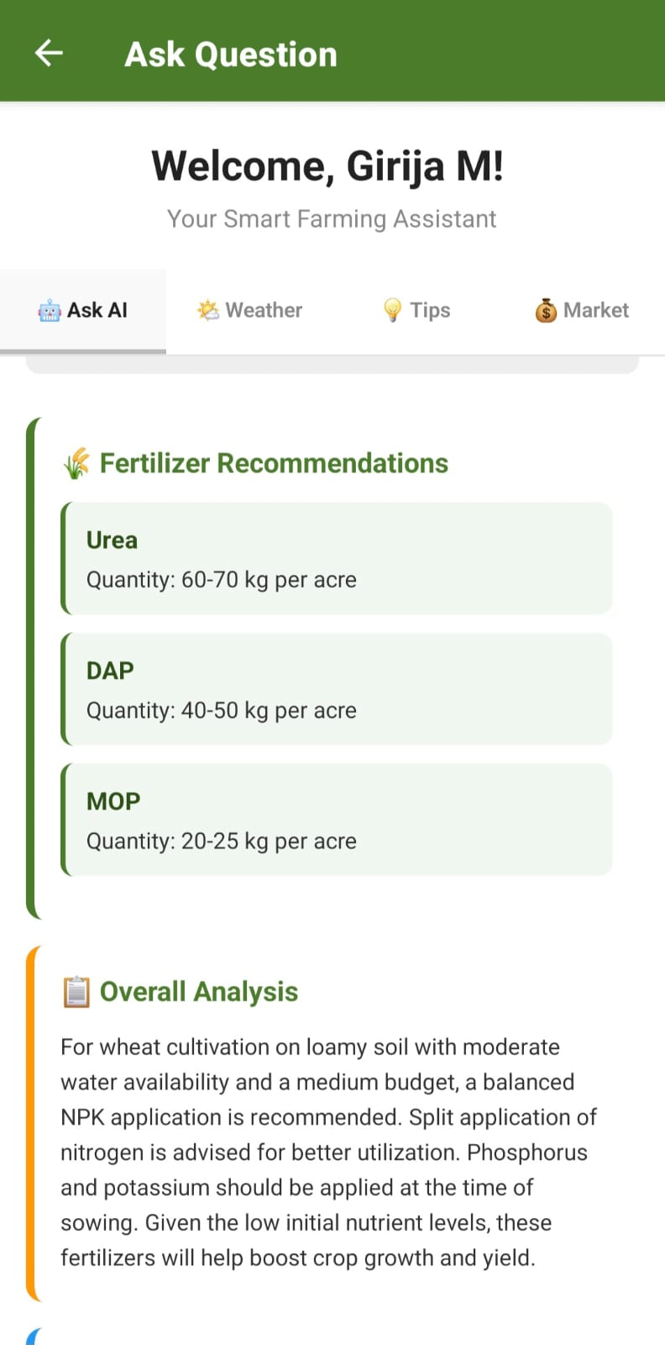
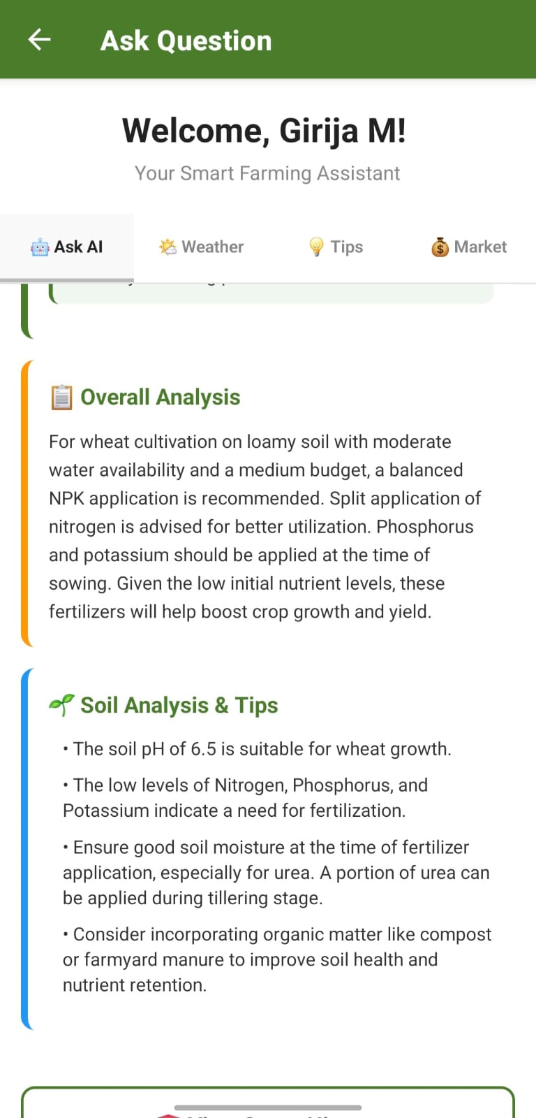
Output :-
AI Interface Page

Slide 7
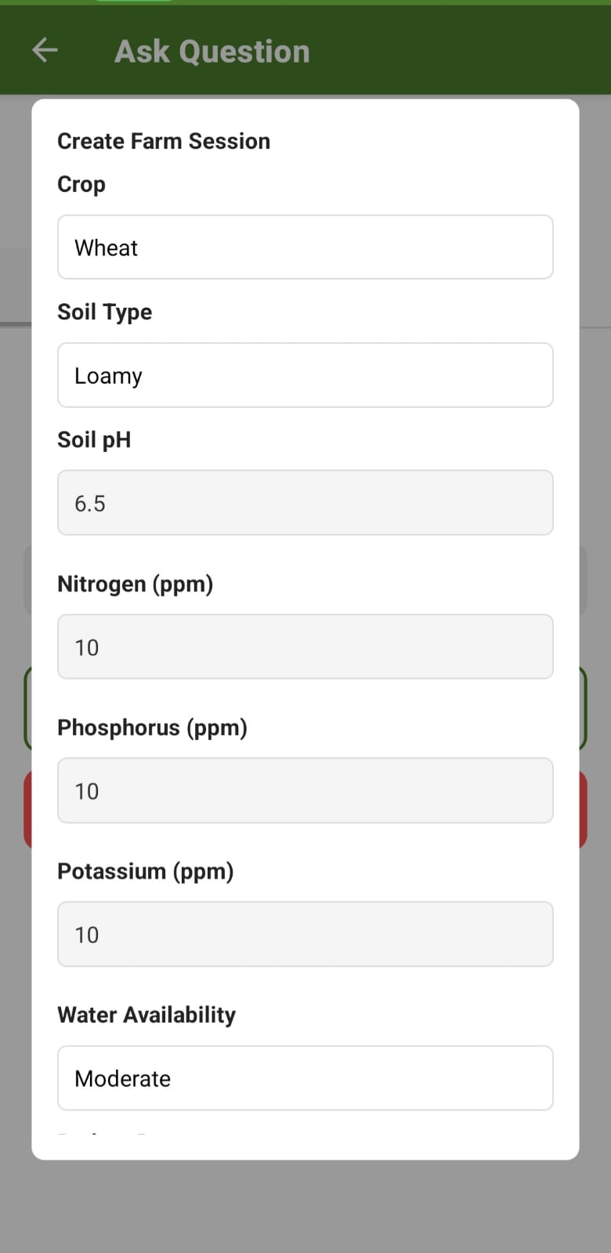
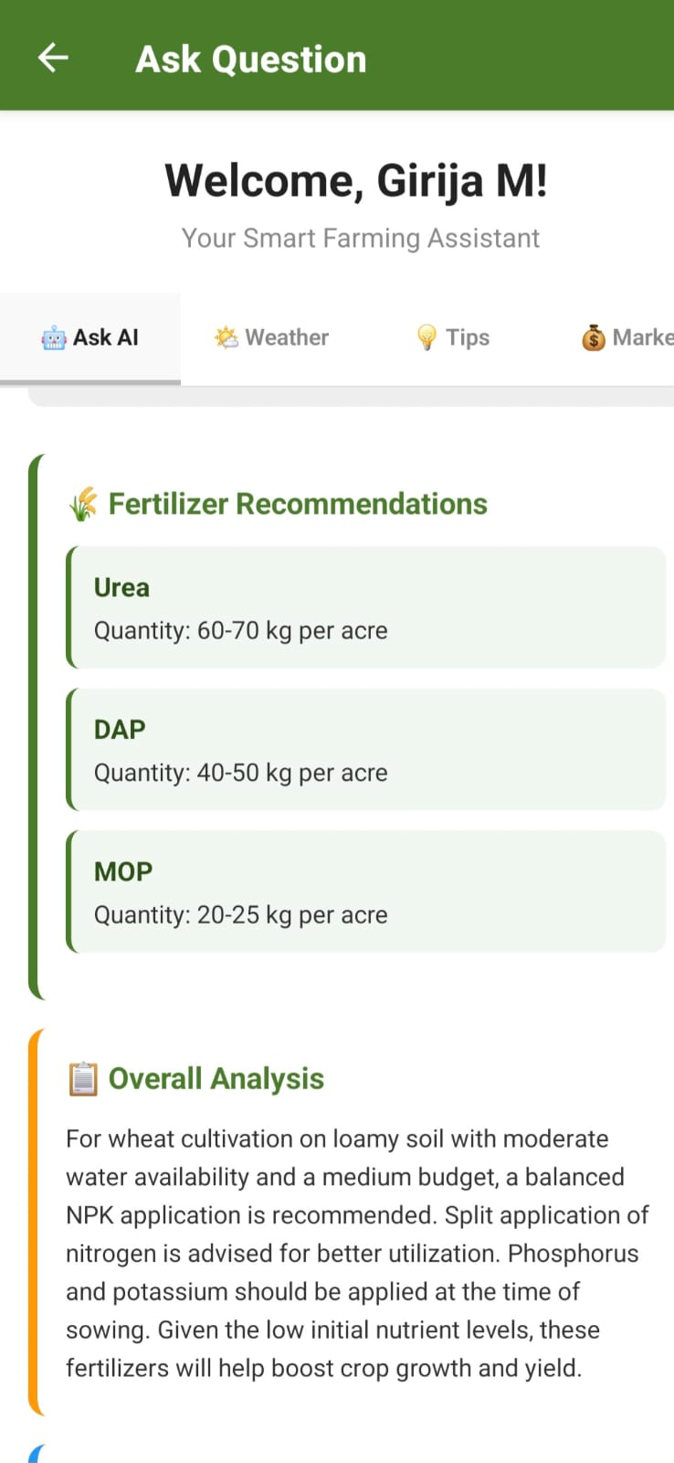
Fertilizer Recommendations Interface Page

Slide 8
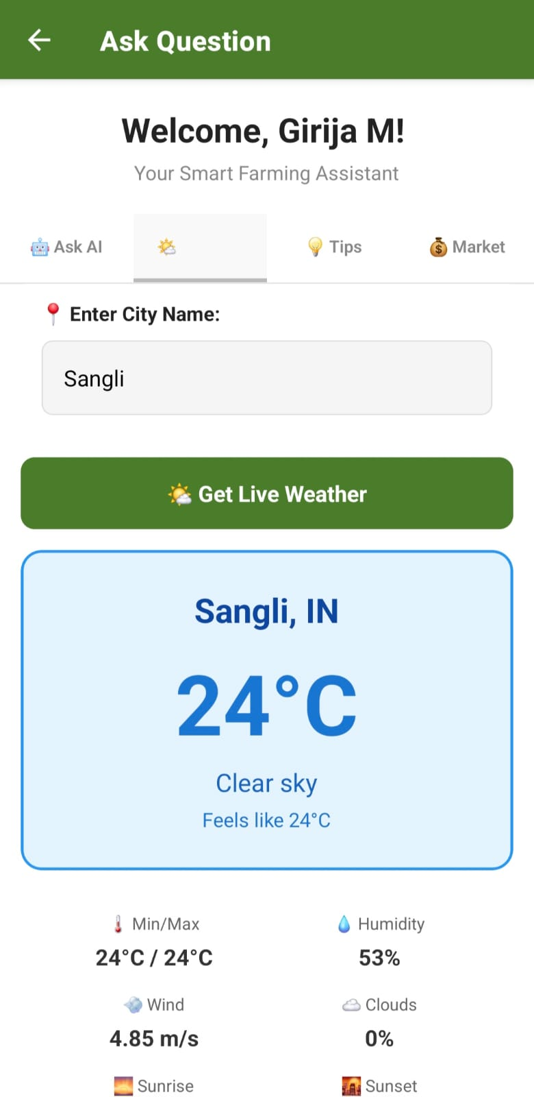
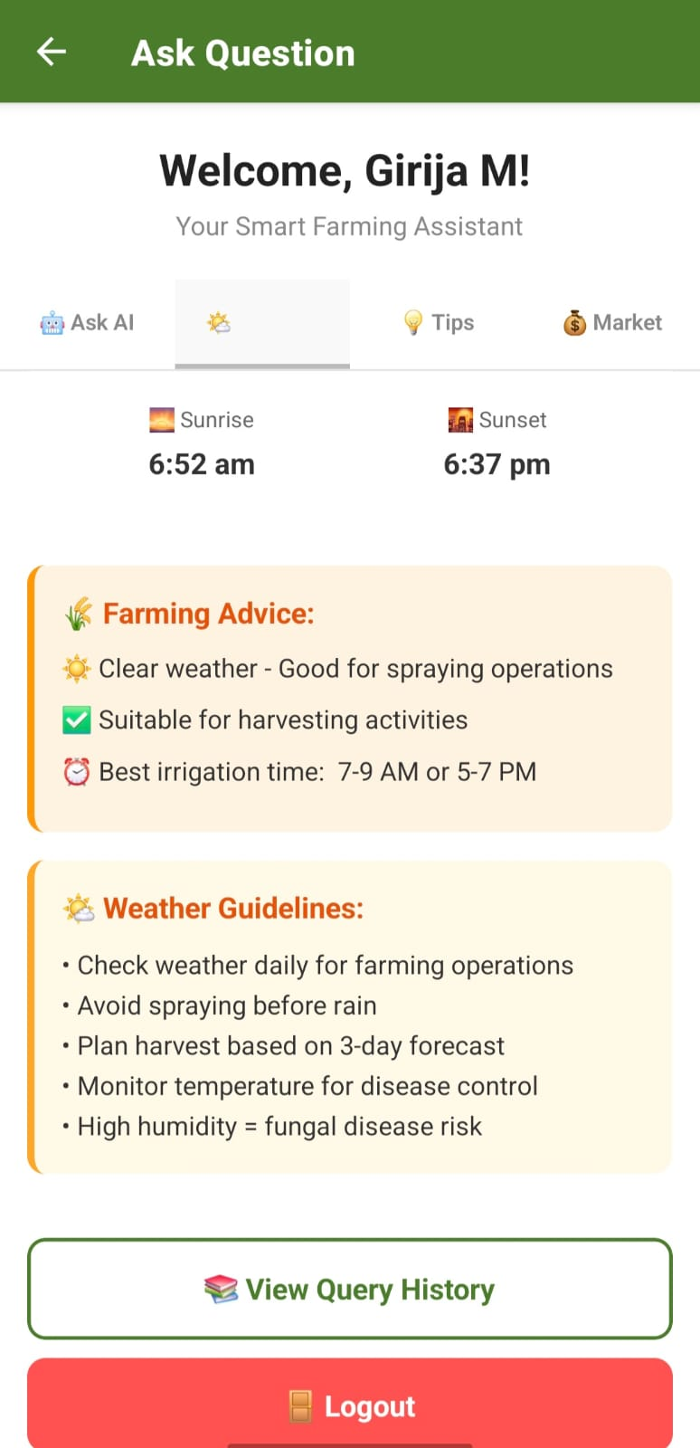
Weather Interface Page

Slide 9
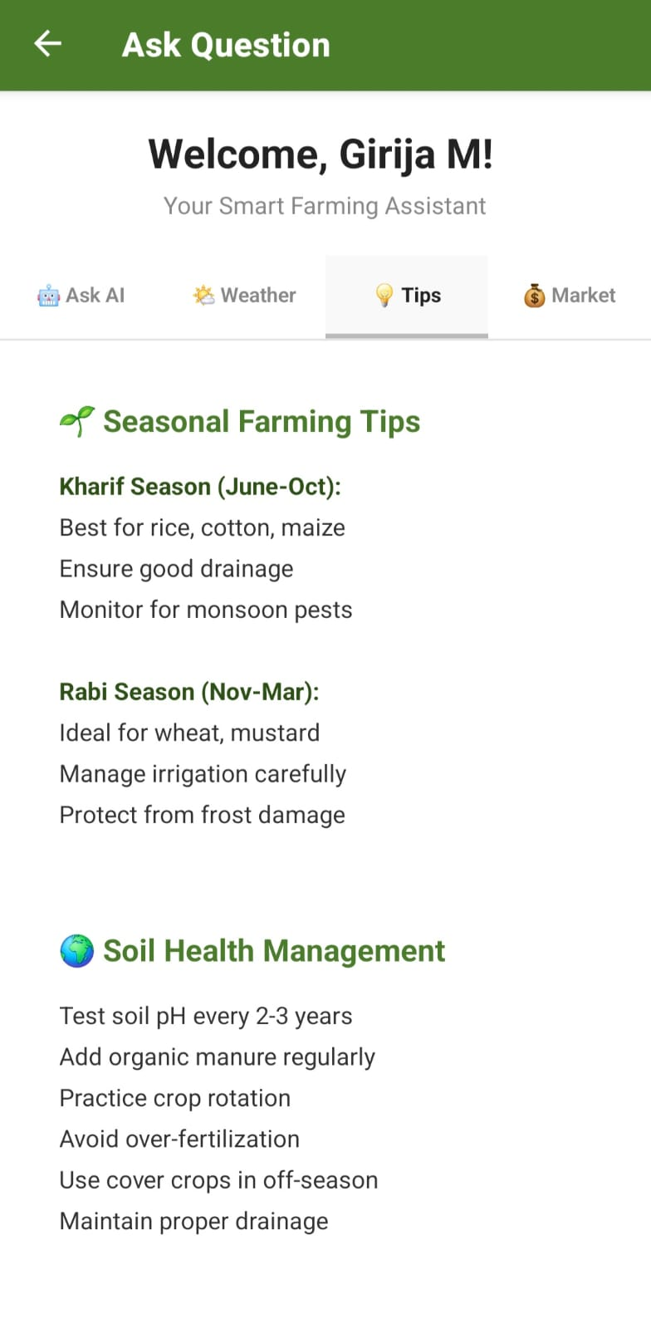
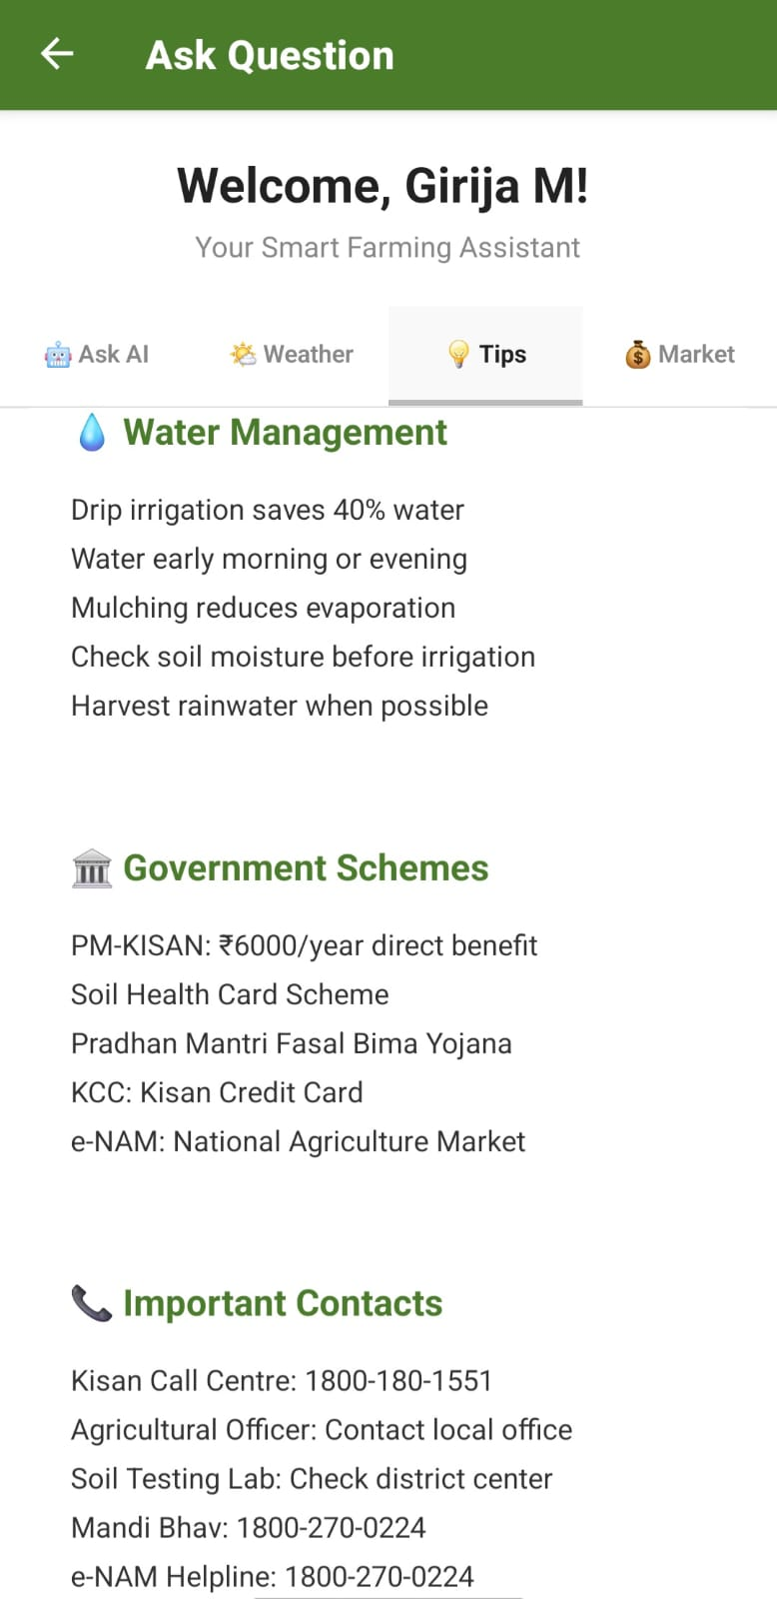
Tips Interface Page

Slide 10
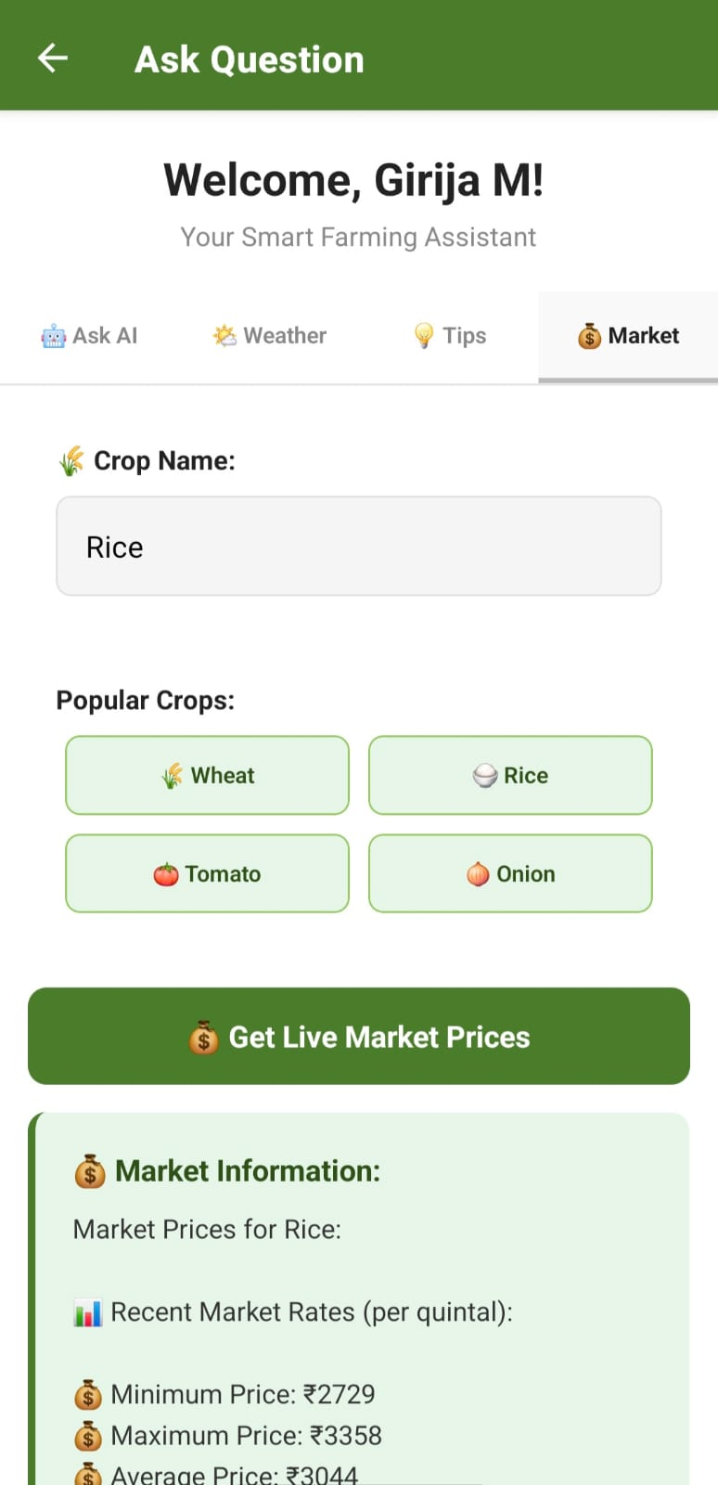
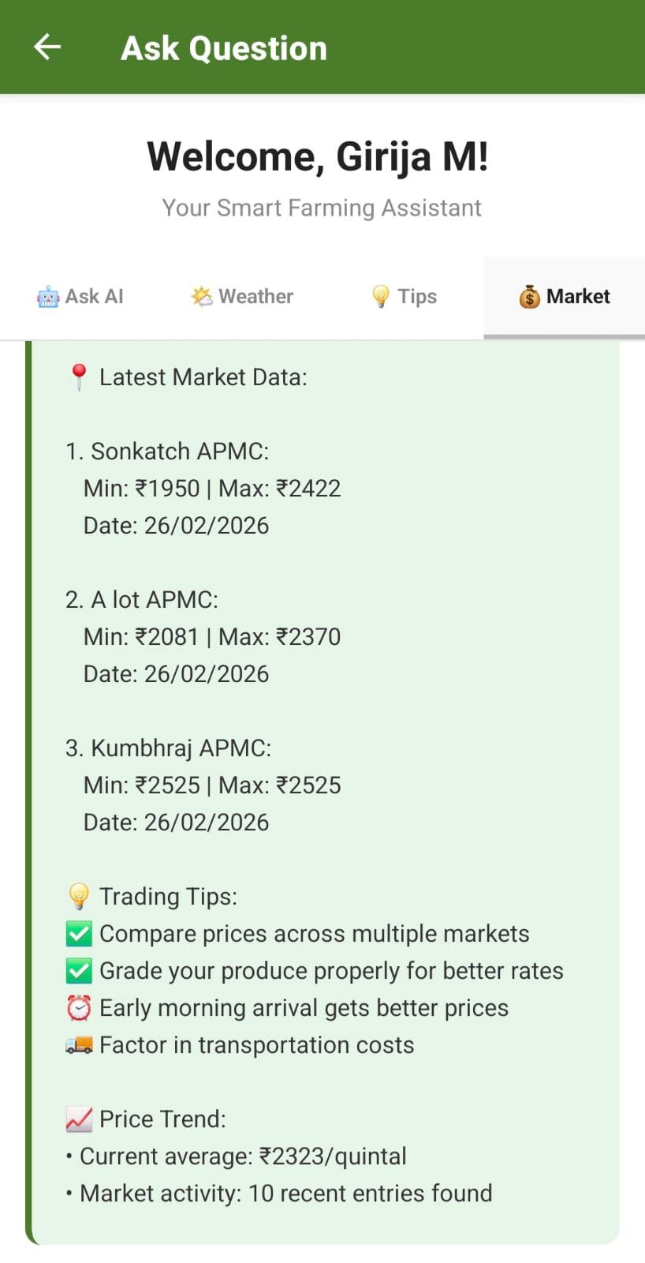
Market Price Interface Page

Slide 11
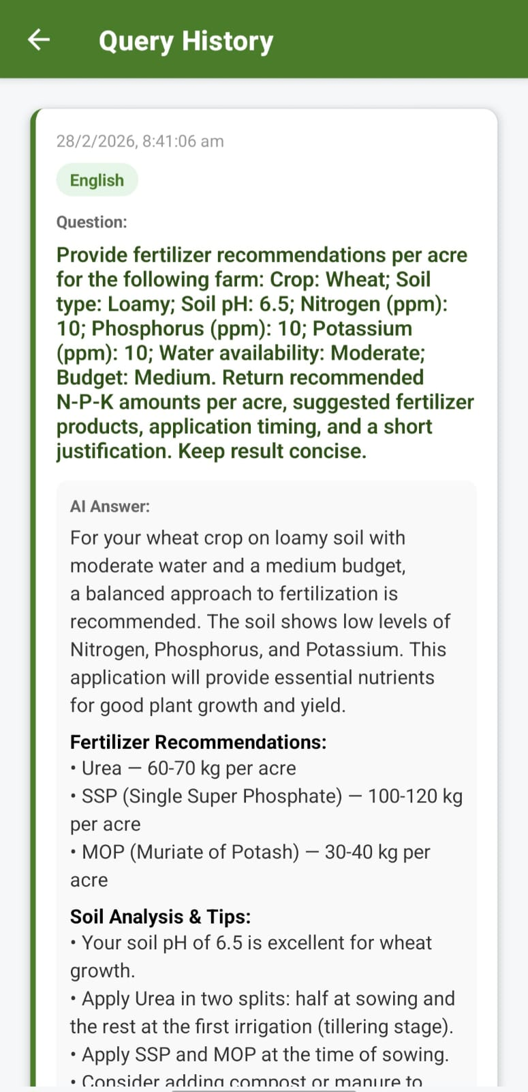
History Of Past Queries Interface Page

Slide 12
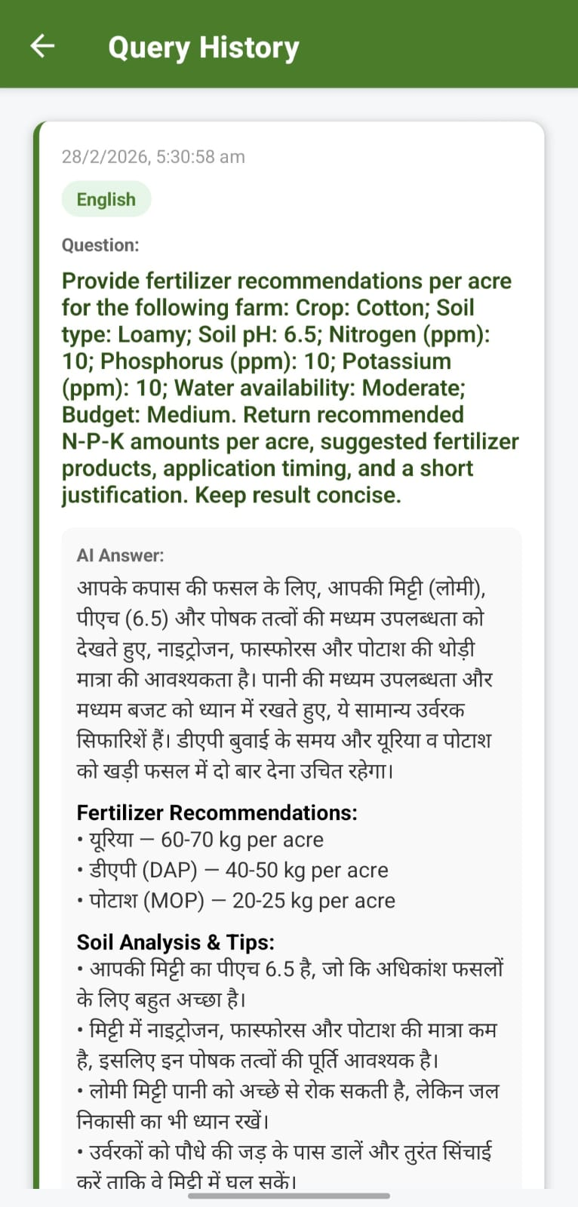
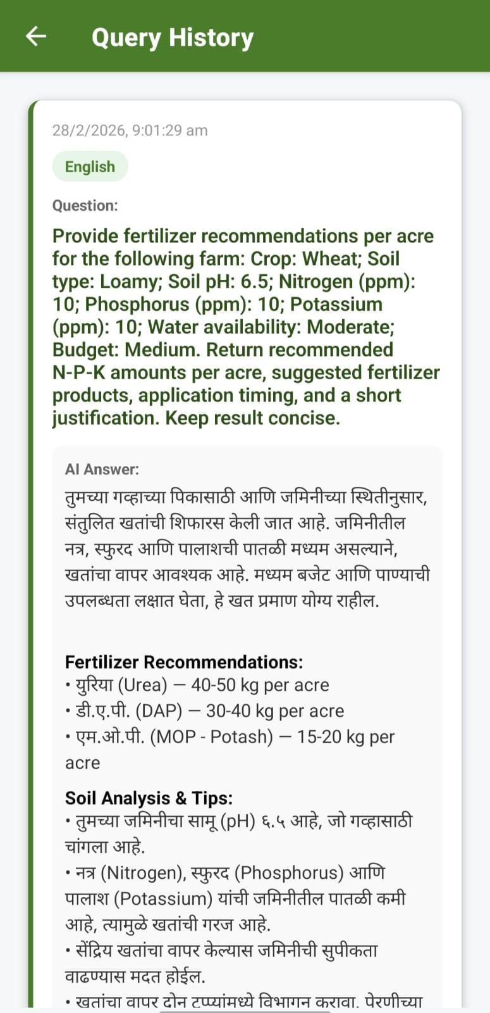
Language Interface -
English,
Hindi,
Marathi

Slide 13

User authentication (signup & login).
Ask AI questions with natural language.
Create farm sessions for fertilizer recommendations.
View history of past queries and answers.
Multi-language support.
Supplemental tips, weather and market information.

Slide 14
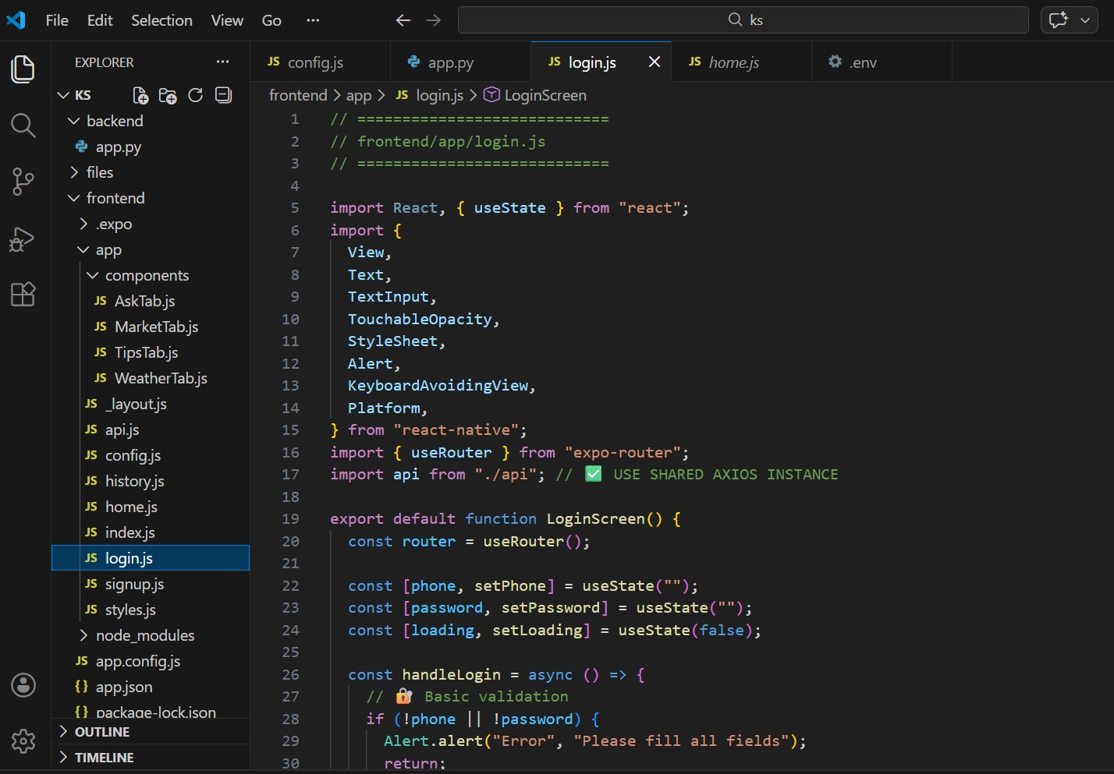
Code :

Slide 15
Architecture :-
Mobile user interacts with the Expo (React Native) app.
Expo app sends the user input the Flask backend.
Flask backend processes the request & :
Reads/writes data in the MySQL database.
Requests responses from Gemini AI when needed.
Flask backend combines database data and AI output.
Final result is sent back to the Expo app and displayed to the user.
.

Slide 16
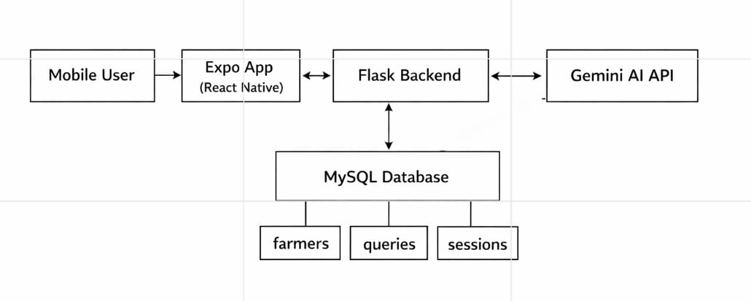
Flow Chart

Slide 17
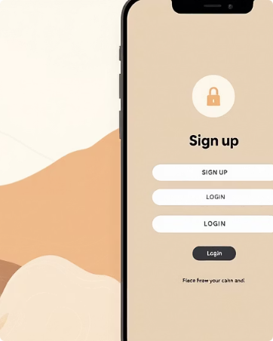

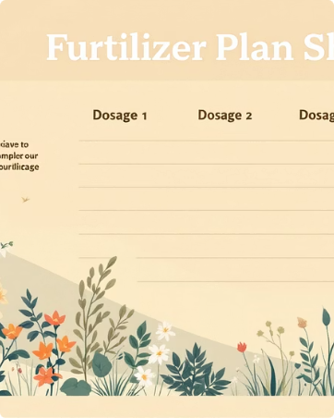
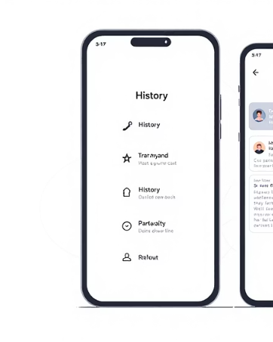
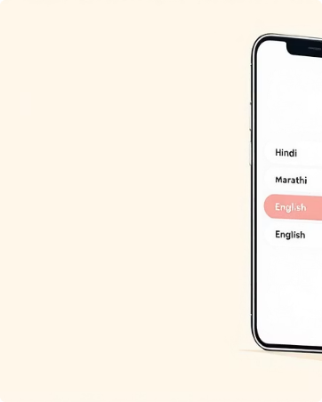
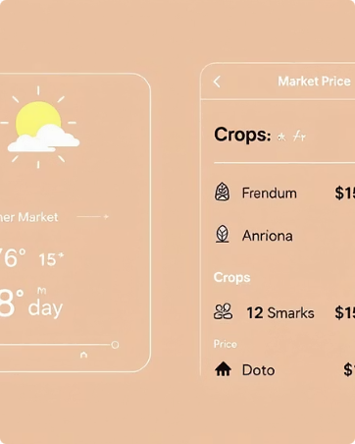
Key Features :-
User authentication
Ask AI questions
Farm Sessions
History & tracking
Phone-based signup/login ensures simple, secure access.
Natural language chat for pest ID, treatment, and agronomic advice.
Create structured fertilizer sessions with dosages and timelines.
Review past queries, follow-up notes, and applied recommendations.
Multi-language support
Supplemental info/Tips
English, Hindi, and Marathi with localization for local terms.
Weather alerts, short practical tips, and local market signals.

Slide 18

THANK YOU !!!

